Slide 1
Anomaly Detection
Krishna.S.S

Slide 2
What is anomaly Detection
Anomaly detection is the process of finding outliers in a given dataset
Outliers are the data objects that standout amongst other objects in the dataset and do not conform to the normal behaviour in a dataset
Anomaly detection is the identification of datapoints events or observations that deviate from datasets normal behavioural patterns
Anomaly detection is an important supervised data processing task which enables us to detect abnormal behaviour without having a priori knowledge of possible abnormalities

Slide 3

cntd
An anomaly can be defined as a pattern in the data that doesnot conform to a well defined notion of normal behaviour

Slide 4
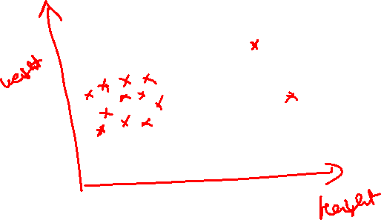


Slide 5
Different Categories of Anomalies
On this basis we can categorise anomalies in the data into three categories
Outliers- Short anomalies patterns that appear in a non systematic way in the collected data usually arising due to noise or faults for example due to communication errors

Slide 6
Cntd
Events/ Change : These patterns appear with a systematic and sudden change from previously known normal behaviour
The duration of these patterns is usually longer than outliers
In environmental monitoring extreme weather conditions are examples of events.
The start of an event is usually called a change point

Slide 7
Drifts
Slow , Unidirectional long term changes in data.
This usually happens due to the onset of a fault in a sensor

Slide 8
Anomalies in the real world
Suppose you are a credit card holder and on an unfortunate day it got stolen. Payment processing companies (like PayPal) do keep a track of your usage pattern so as to notify in case of any dramatic change in the usage patterns
The patterns include transaction amounts, the location of transactions and so on
If a credit card is stolen, it is very likely that the transactions may vary largely from the usual ones
This is where the companies use the concepts of anomalies to detect the unusual transactions that may take palce after the credit card theft

Slide 9

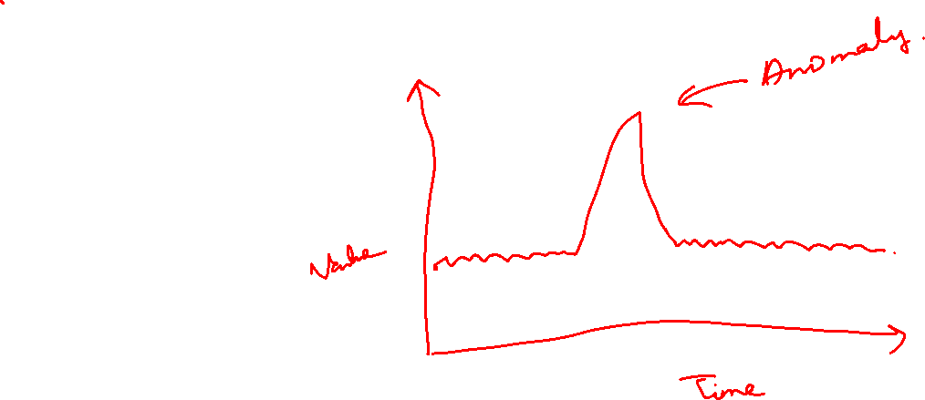
cntd

Slide 10
Global Anomalies
Global anomalies are the most common types of anomalies and correspond to those datapoints which deviate largely from the rest of the datapoints

Slide 11
Contextual Anomalies
From the archives of “The Washington Post”
Alska just finished one of its most unusually warm marches ever recorded. In its northern reaches , the March warmth was unprecedented.
Take note of the phrase “unusually warm”. It rfers to 59 degrees Fahrenheit
But this may not be unusually warm for other countries.
This unusual warmth is anomaly here

Slide 12
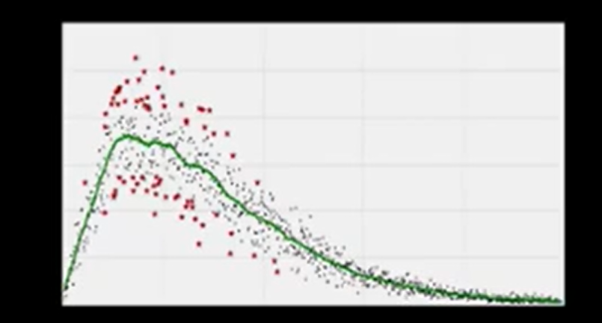

Slide 13
